Slide 1

Business questions answered by SQL
Abdulaziz ismaeil

Slide 2
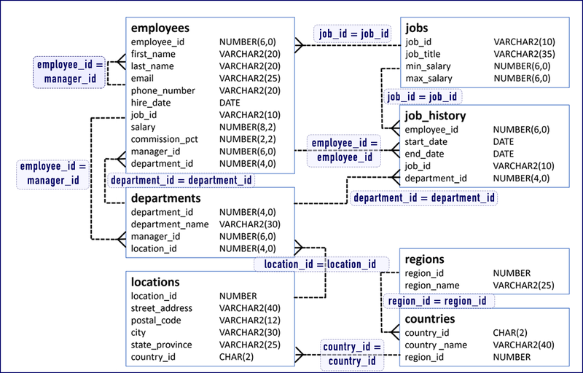
Human Resources Schema

Slide 3
Business Questions
How do we calculate the raise percentage the employees get based on what bracket their pay range belongs in?
What job positions in the company are the closest to their maximum pay value?
How many employees have joined a specific year and what departments have hired them?

Slide 4
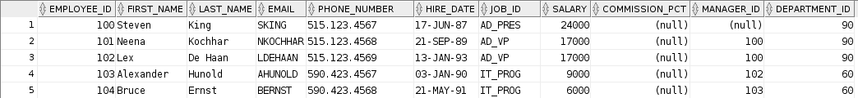

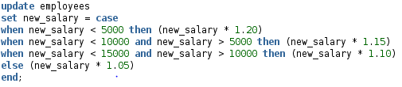
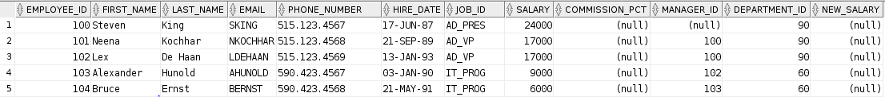


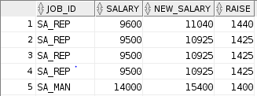
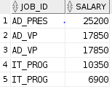

How do we calculate the amount of raise the employees get based on what bracket their pay range belongs in?

Slide 5
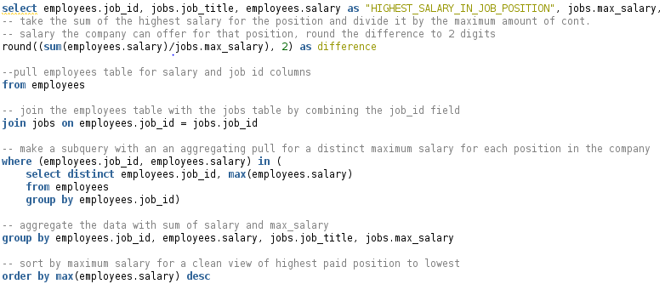
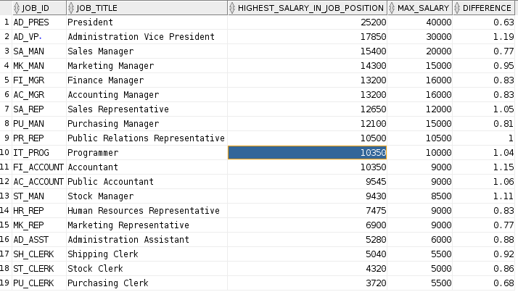
What job positions in the company are the closest to their maximum pay value?

Slide 6
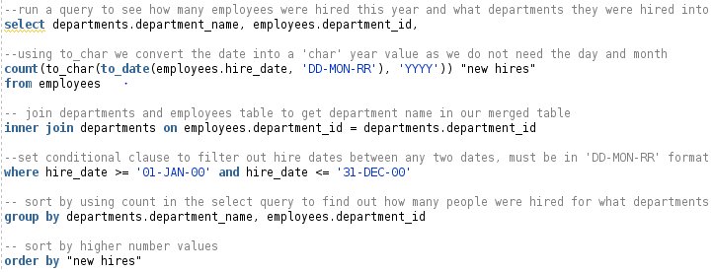

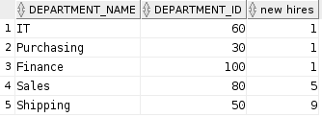
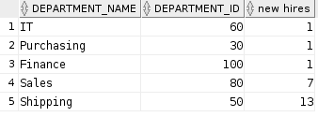
How many employees have joined a specific year and what departments have hired them?
Example Outputs
Year 2000
Year 1999
Year 1998

